Slide 1
Hospital emergency ROOM Analysis
Dashboard

Slide 2
Purpose of project
We need a create a Hospital Emergency Room Analysis Dashboard in Excel to improve efficiency and provide useful insights. This Dashboard will help stakeholders monitor, Analyze, and make better decision for managing patients and improving services.

Slide 3
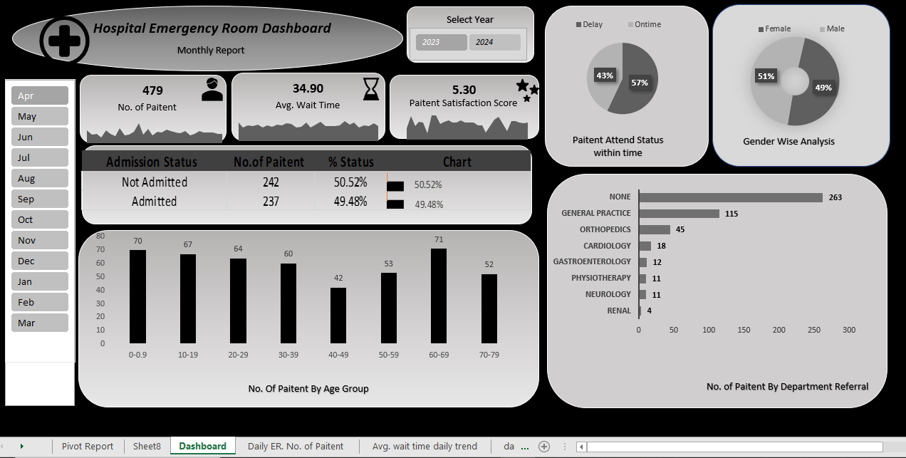

Slide 4
Project steps
Business Requirement gathering
Understanding of data
Data Collection
(Import Data Using Power Query)
Data Cleaning and Data Quality check using Power Query
Creating Calendar Table
Data Modeling Power Pivot
Adding Required Columns(DAX Calculated in Power pivot )
Creating pivots and Dashboard Lay outing
Charts Development and Formatting
Dashboard / Report Development
Insights Generation

Slide 5



KPI’S REQUIREMENT
Number of patients:
Count the total number of patients waiting the ER each day.
Show a daily trend with an area sparkline to spot patterns like busy days or seasonal trends.
Average wait time:
Find the average time patients wait to see a medical professional.
use an area sparkline to track daily changes and highlight days with longer wait time that might need improvement's
Patient satisfactory score:
Check the average daily satisfaction score of patients to assess service quality.
Use an area sparkline to show trends, spot drops in satisfaction, and link them to busy challenges.

Slide 6

CHARTS TO CREATE:-
Patient admission Status: Show how many patients were admitted vs. not admitted.
Patient Age Distribution: Group patients by age.
Timelines : Measures the Percentage of patients seen within 30min.
Gender Analysis: Display the number of patients by gender.
Department Referral: Check Which departments patients are referred to the most.

Slide 7
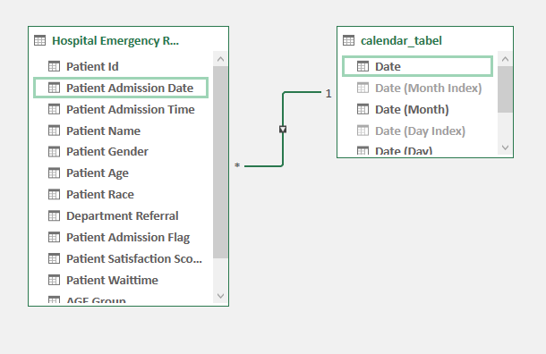
Formula
Calendar Table Formula:-
List. Dates(#dates(2023,01,01),731,#duration(1,0,0,0))
Data View of calendar Relationship:

Slide 8
Age calculation by group
=IF ([Patient Age]>70,”70-79”, IF ([Patient Age]>60,”60-69”, IF ([Patient Age]>50,”50-59”, IF ([Patient Age]>40,”40-49”, IF ([Patient Age]>30,”30-39”, IF ([Patient Age]>20,”20-29”, IF ([Patient Age]>10,”10-09”,0-0.9 )
=IF([patient wait time]>30,”Delay”,”Ontime”)

Slide 9
Thank You

